Slide 1

Student Performance Report
Analyzing academic performance in Mathematics and Portuguese to identify key factors influencing final grades and student success.

Slide 2

RESEARCH QUESTION
Understanding Academic Success
The Challenge
Students' academic performance is influenced by multiple personal, family, and lifestyle factors. However, it's not always clear which factors significantly affect final achievement.
Our Focus
Which background, family, lifestyle, and academic behavior factors significantly influence students' final grades?

Slide 3




Student Demographics
56.6%
91.5%
Female Students
Higher Education Interest
Gender distribution in study
Students pursuing further studies
79.2%
62.2%
Internet Access
Portuguese Focus
Students with home connectivity
Observations from Portuguese vs. 37.8% Math

Slide 4
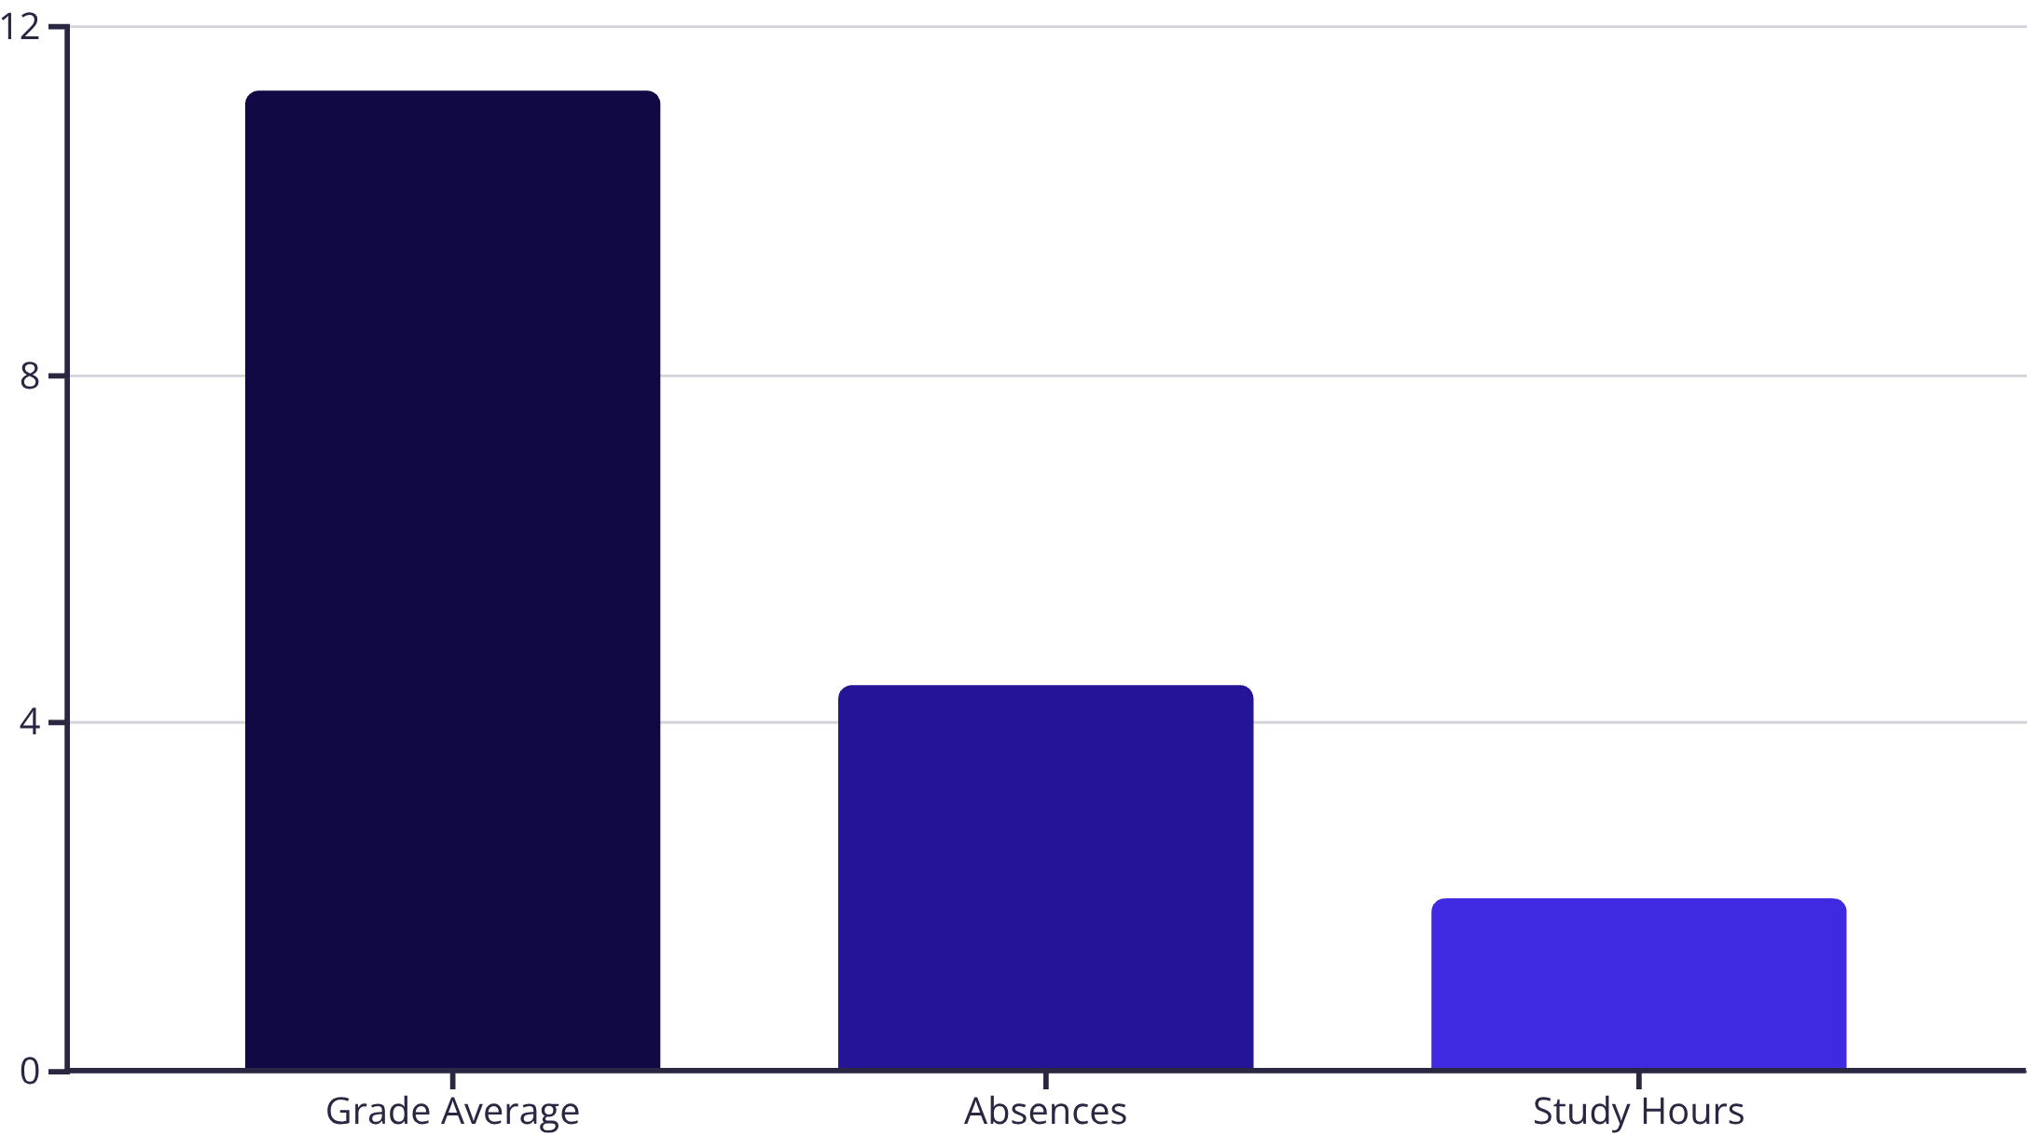
Academic Performance Overview
Key Metrics
Students averaged 11.26 across all grading periods (G1, G2, G3), with an average of 4.43 absences and 1.97 hours of daily study time.
These baseline metrics provide context for understanding performance patterns across subjects and student groups.

Slide 5
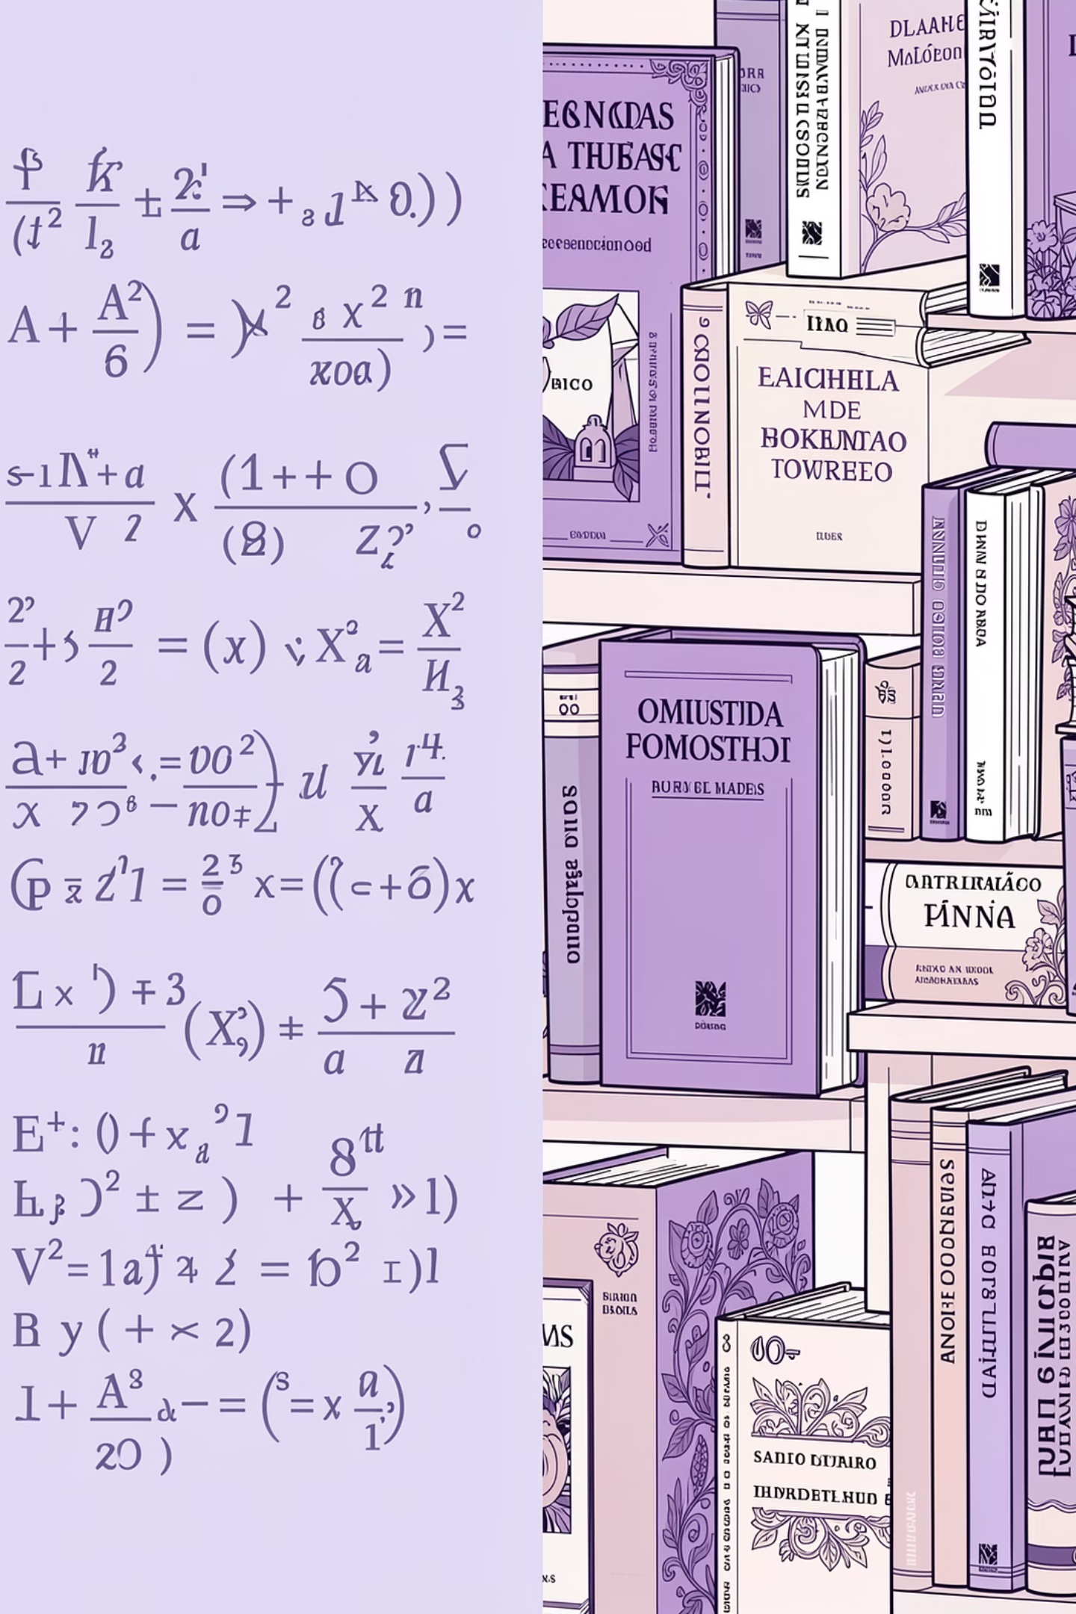
Subject Performance Comparison
Portuguese Performance
Study Time Paradox
Students studied more for Mathematics (2 hours) vs. Portuguese (1.9 hours)
Students performed significantly better in Portuguese than Mathematics (p < 0.05)
Key Insight
Despite more study time, Mathematics performance remained lower than Portuguese

Slide 6




Understanding Statistical Significance
p-value
Beta (β)
R-squared (R²)
Eta Squared (η²)
Shows whether results are statistically significant. If p < 0.05, the result is considered meaningful.
Shows strength and direction of a predictor. Higher absolute β means stronger influence on outcomes.
Shows how much variance the model explains. Higher R² indicates better predictive fit.
Measures effect size, showing how much variance a factor explains in the dependent variable.

Slide 7

Lifestyle Factors: Small but Significant
Study Time
F(3,1040) = 10.37, p < .001
Workday Alcohol (η²=2.3%)
Effect size: η² = .029
Study Time (η²=2.9%)
Workday Alcohol
F(4,1039) = 6.24, p < .001
Effect size: η² = .023
Weekend Alcohol (η²=1.4%)
Weekend Alcohol
F(4,1039) = 3.78, p < .005
Effect size: η² = .014
All three factors showed statistical significance but explained minimal variance in final grades.

Slide 8

The Power of Prior Performance
Multiple linear regression revealed that previous academic achievement is the strongest predictor of final grades.
84.2%
.797
.108
Model Accuracy
G2 Beta Coefficient
G1 Beta Coefficient
R² = .842, explaining variance in final grades (F(11,1032) = 500.53, p < .001)
Second-period grades: strongest predictor of final performance
First-period grades also significantly predict final outcomes

Slide 9
Predicting Pass or Fail
Logistic Regression Results
Key Finding
χ² = 163.45, p < .001
The model successfully predicts passing students but has limited ability to identify those at risk of failing.
Nagelkerke R² = .222
Previous academic failures significantly reduce the probability of passing, highlighting the importance of early intervention.
Overall accuracy: 80.7%
Significant Predictors
Study time (OR = 1.256) increases pass likelihood
Previous failures (OR = 0.343) reduce pass probability
Course subject (OR = 2.662) affects pass rates

Slide 10




Conclusions and Implications
Academic History Dominates
Prior grades (G1, G2) are the strongest predictors of final performance
Early Intervention Critical
Previous failures significantly reduce pass probability—catch students early
Lifestyle Factors Secondary
Study time and alcohol consumption show statistical significance but minimal practical impact after controlling for academic history

